Slide 1
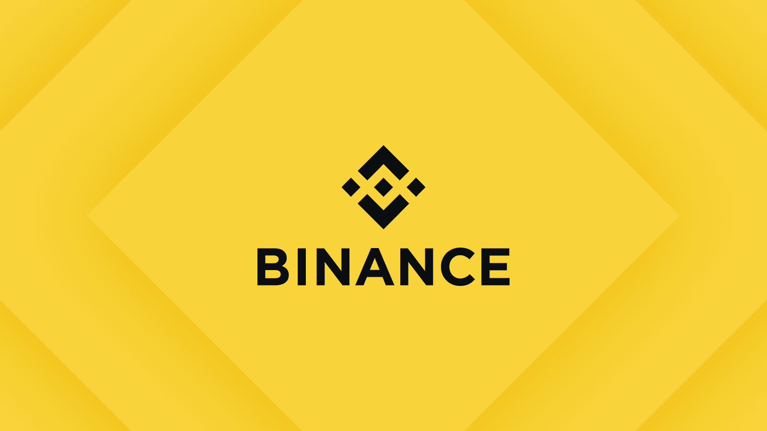
TRADING BOT

Slide 2
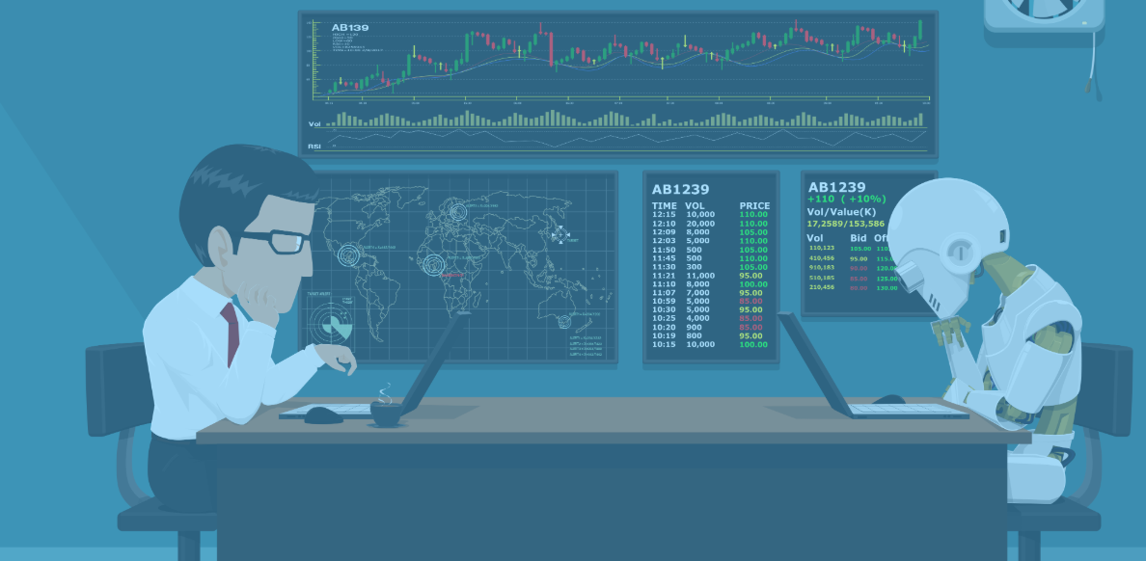
What is a Trading Bot?
- An automated trading system, a subset of algorithmic trading, uses a computer program to create buy and sell orders and automatically submits the orders to a market center or exchange.
Our focus was to have a high profitable trading strategy without having to be in front of the monitors each and every day looking for buy and sell orders.

Slide 3

Why use a Trading Bot?
More Powerful
There is a specific limit to the amount of data a human trader can process at a time. Even if all the data is processed, it is tough to seek insights based on that data. Crypto trading bots can easily handle bulks of data
Efficient
You don’t have to worry about delays and, most importantly, human errors. As long as the bot receives the correct data and is working on suitable algorithms, it can trade assets with a better chance of profit. An added advantage is that these bots can work 24/7.
Emotionless
A bot takes every single decision based on the perceived. Unlike humans, it doesn’t have a fear of loss or greed of profit. Experienced traders may make rational decisions by overpowering their emotions, but that may not always be the case with everybody, especially beginners. On the other hand, a crypto trading bot always keeps emotion out of the equation.

Slide 4


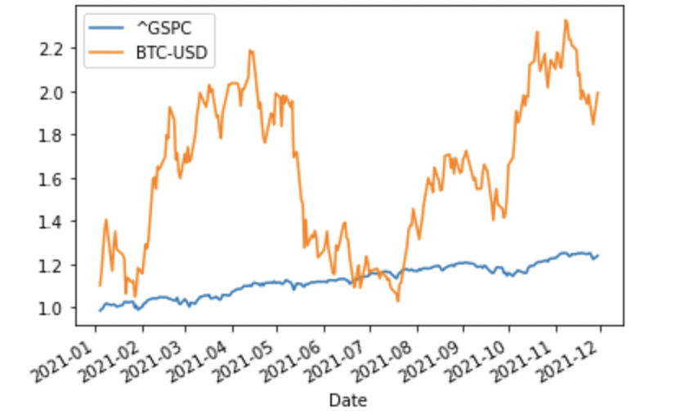
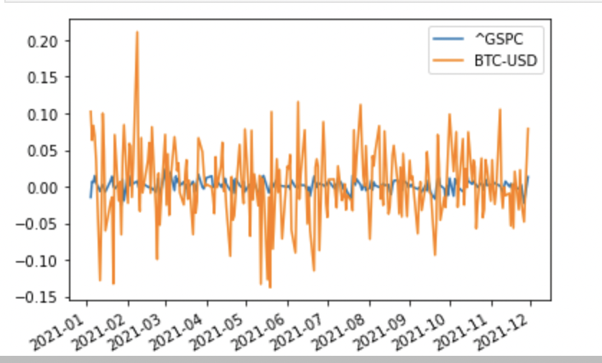
Why not just invest into well known assets like the SP500 or/and Bitcoin?
The S&P500 and Bitcoin are known to be good investments and the historical data confirms that.
Year to date return for 2021:
S&P500 = 27.16%
Bitcoin = 68%

Slide 5

We have utilised two strategies using a slow and fast EMA, RSI and a modified MACD.
Year to date returns on the two have been: 168% and 146% respectively.

Slide 6

A mission to get Damo and Kane to the moon
Our aim to get to the moon is creating a trading bot using Python-Binance.
We will set up the Python wrapper for the Binance API.
What we needed.
- A Binance account
- Python - Binance package
- A trading strategy

Slide 7
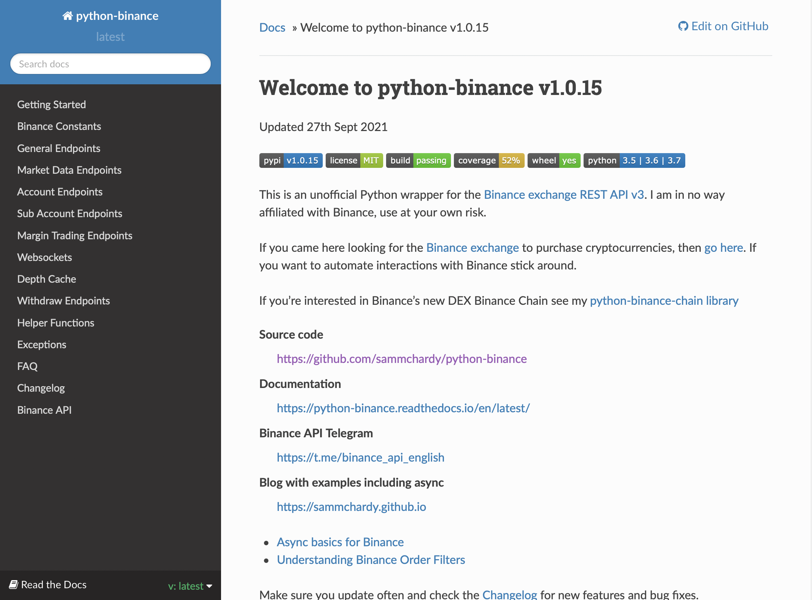
We got all the documentation from the python-finance package.
The API Rate Limit are:
1200 requests per minute.
10 orders per second
100, 000 orders per 24hrs

Slide 8
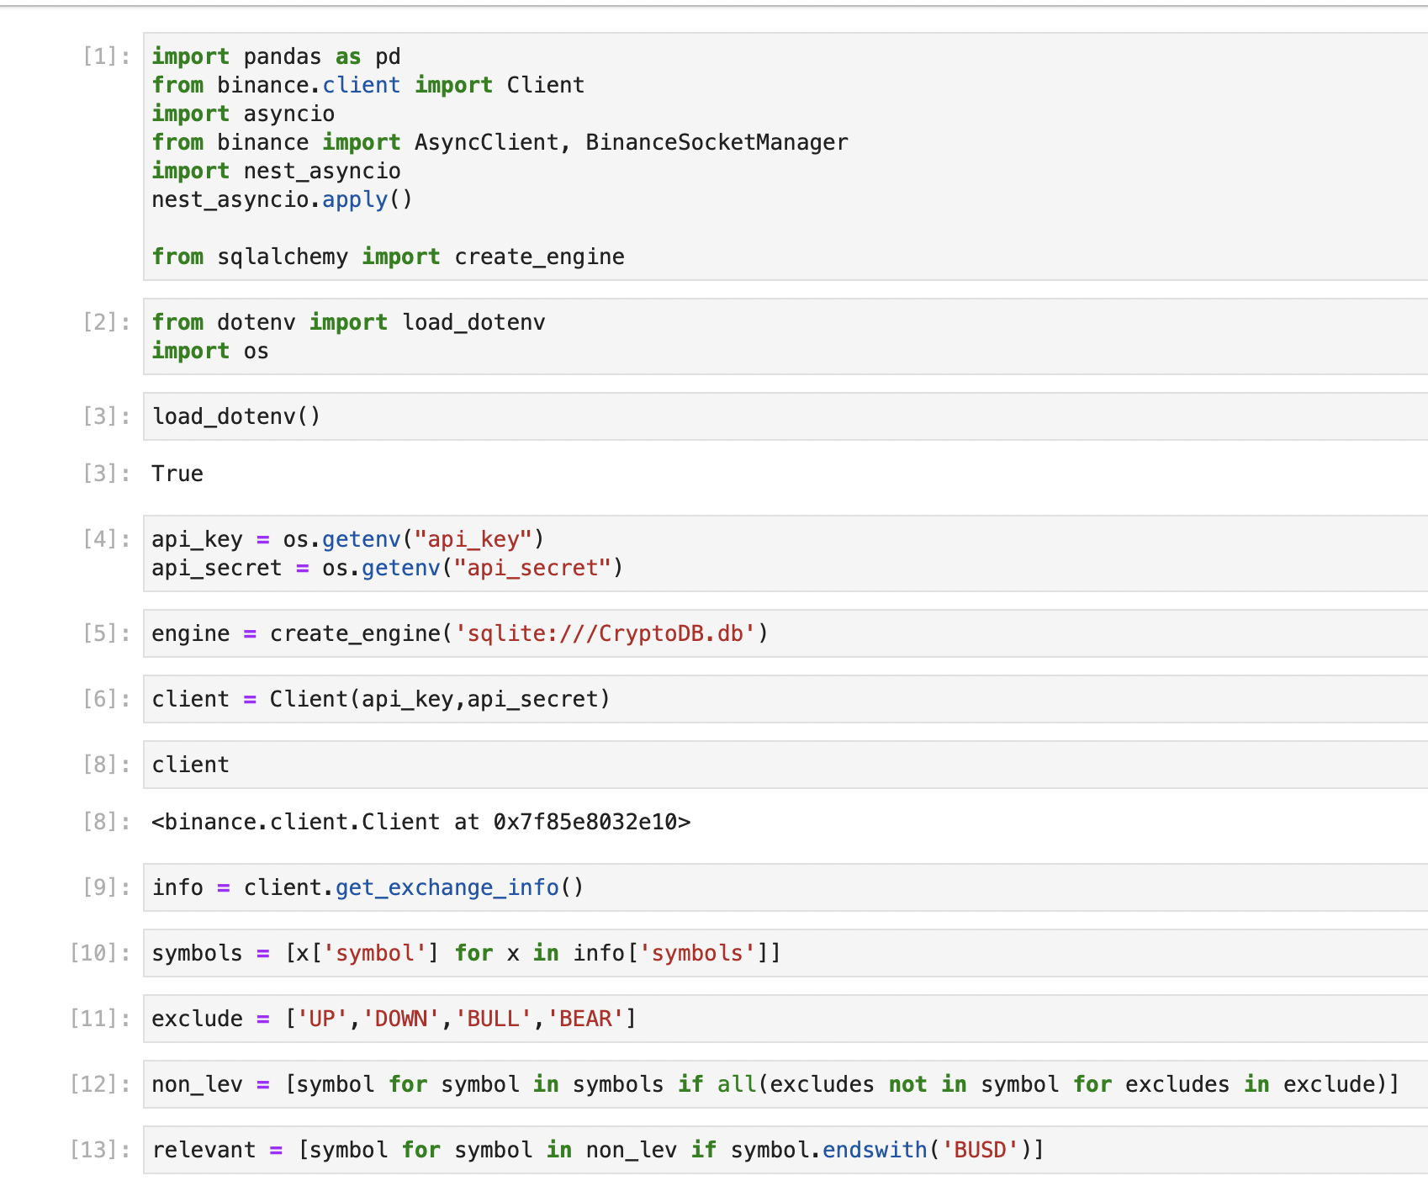
Strategy 1: Buy the top gaining momentum coin
Pandas for data handling
Binance client to get information from Binance
Binance Socket Manager andSQL Alchemy to create a SQL database

Slide 9
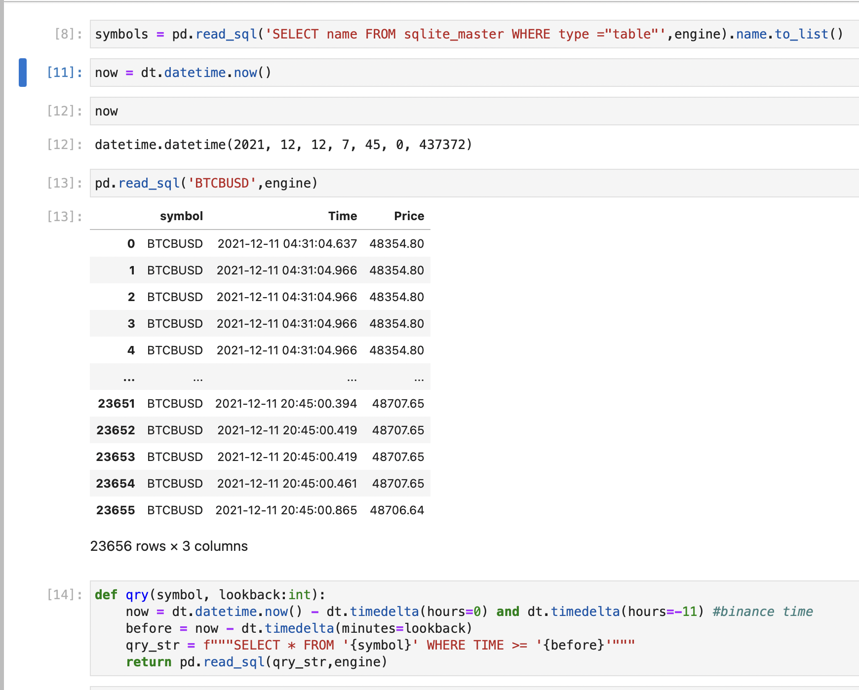
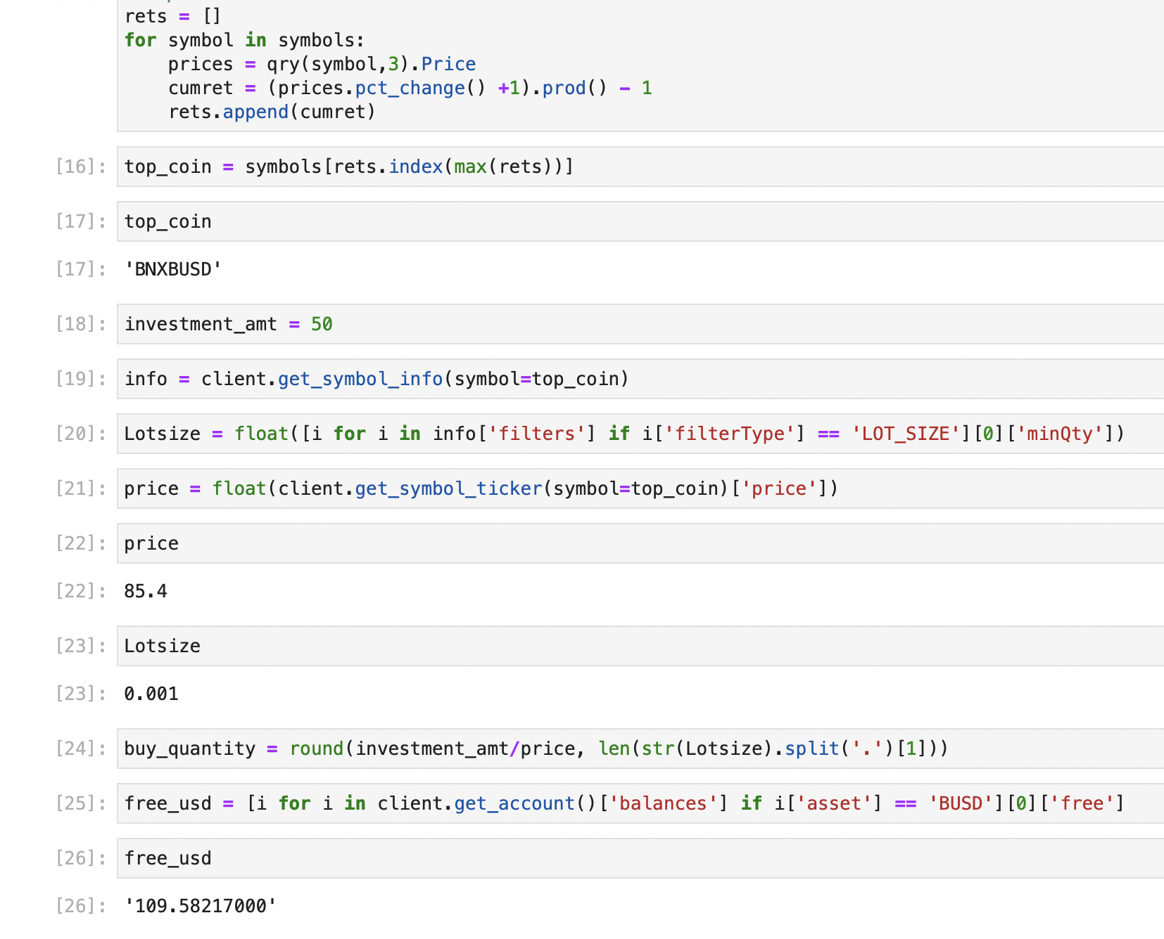

Slide 10
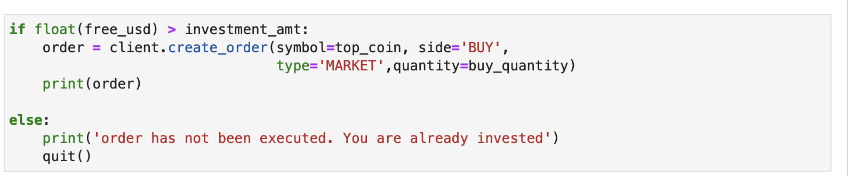
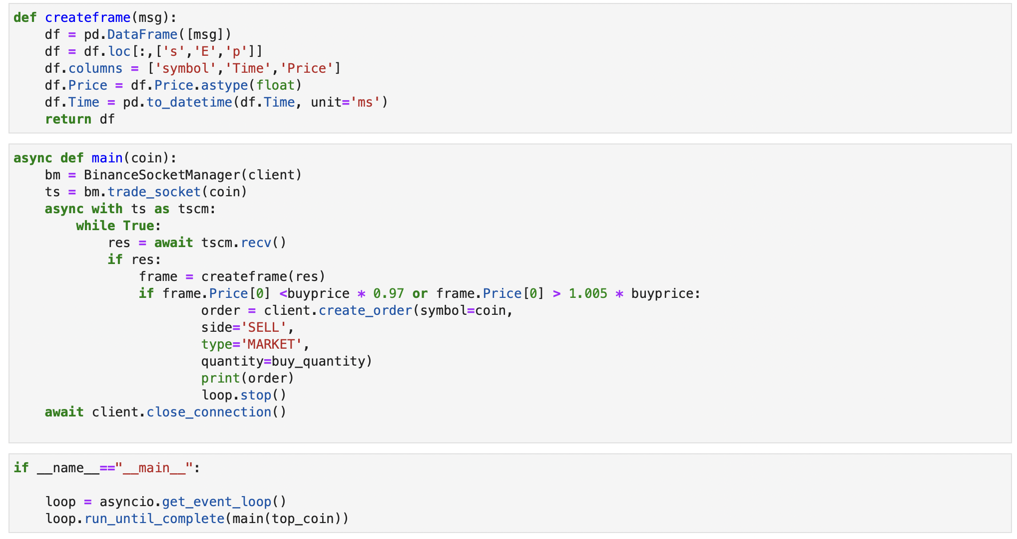

Slide 11
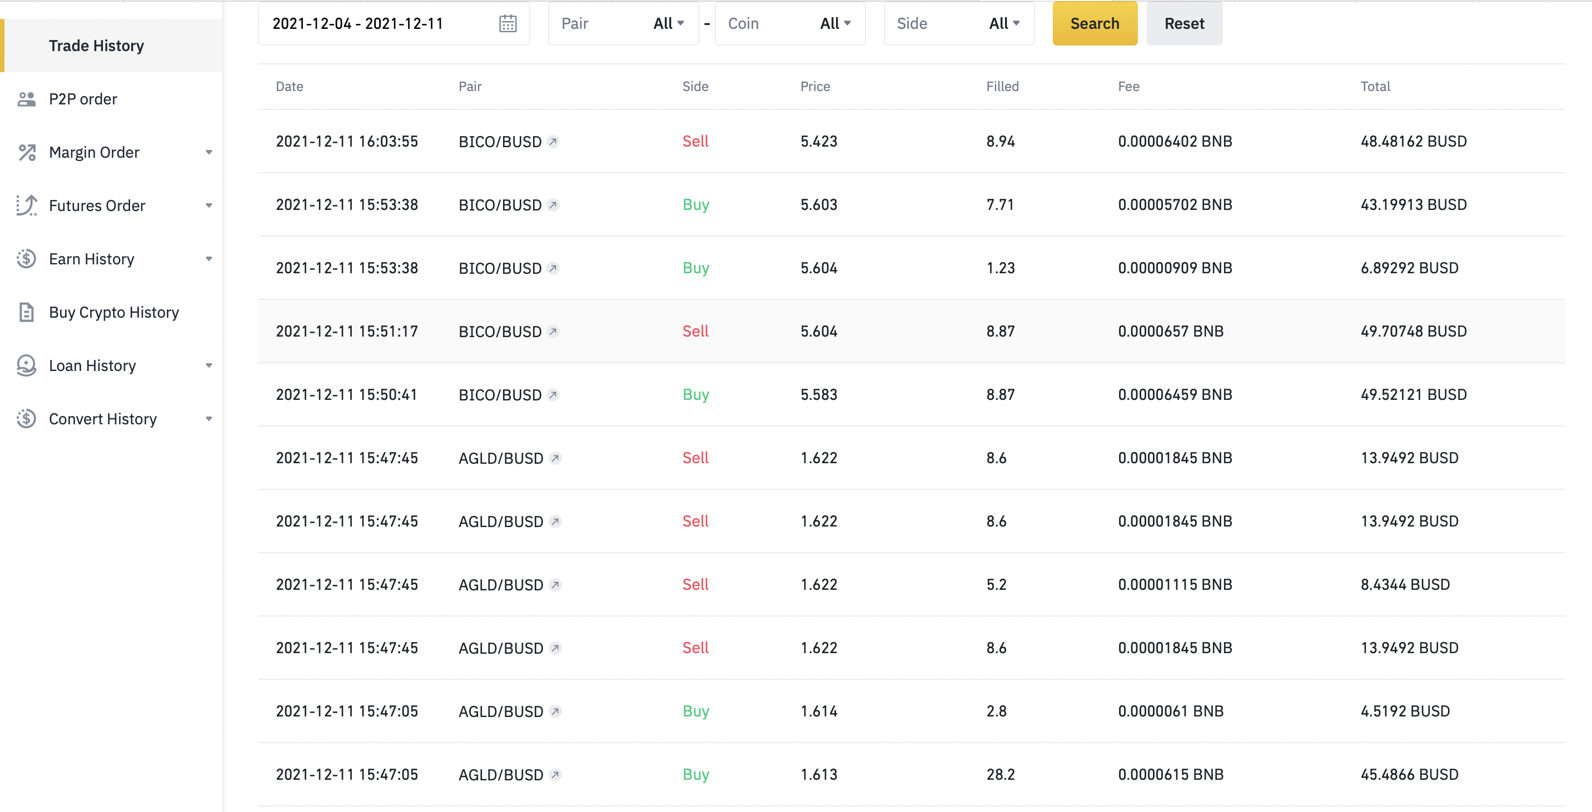

Slide 12
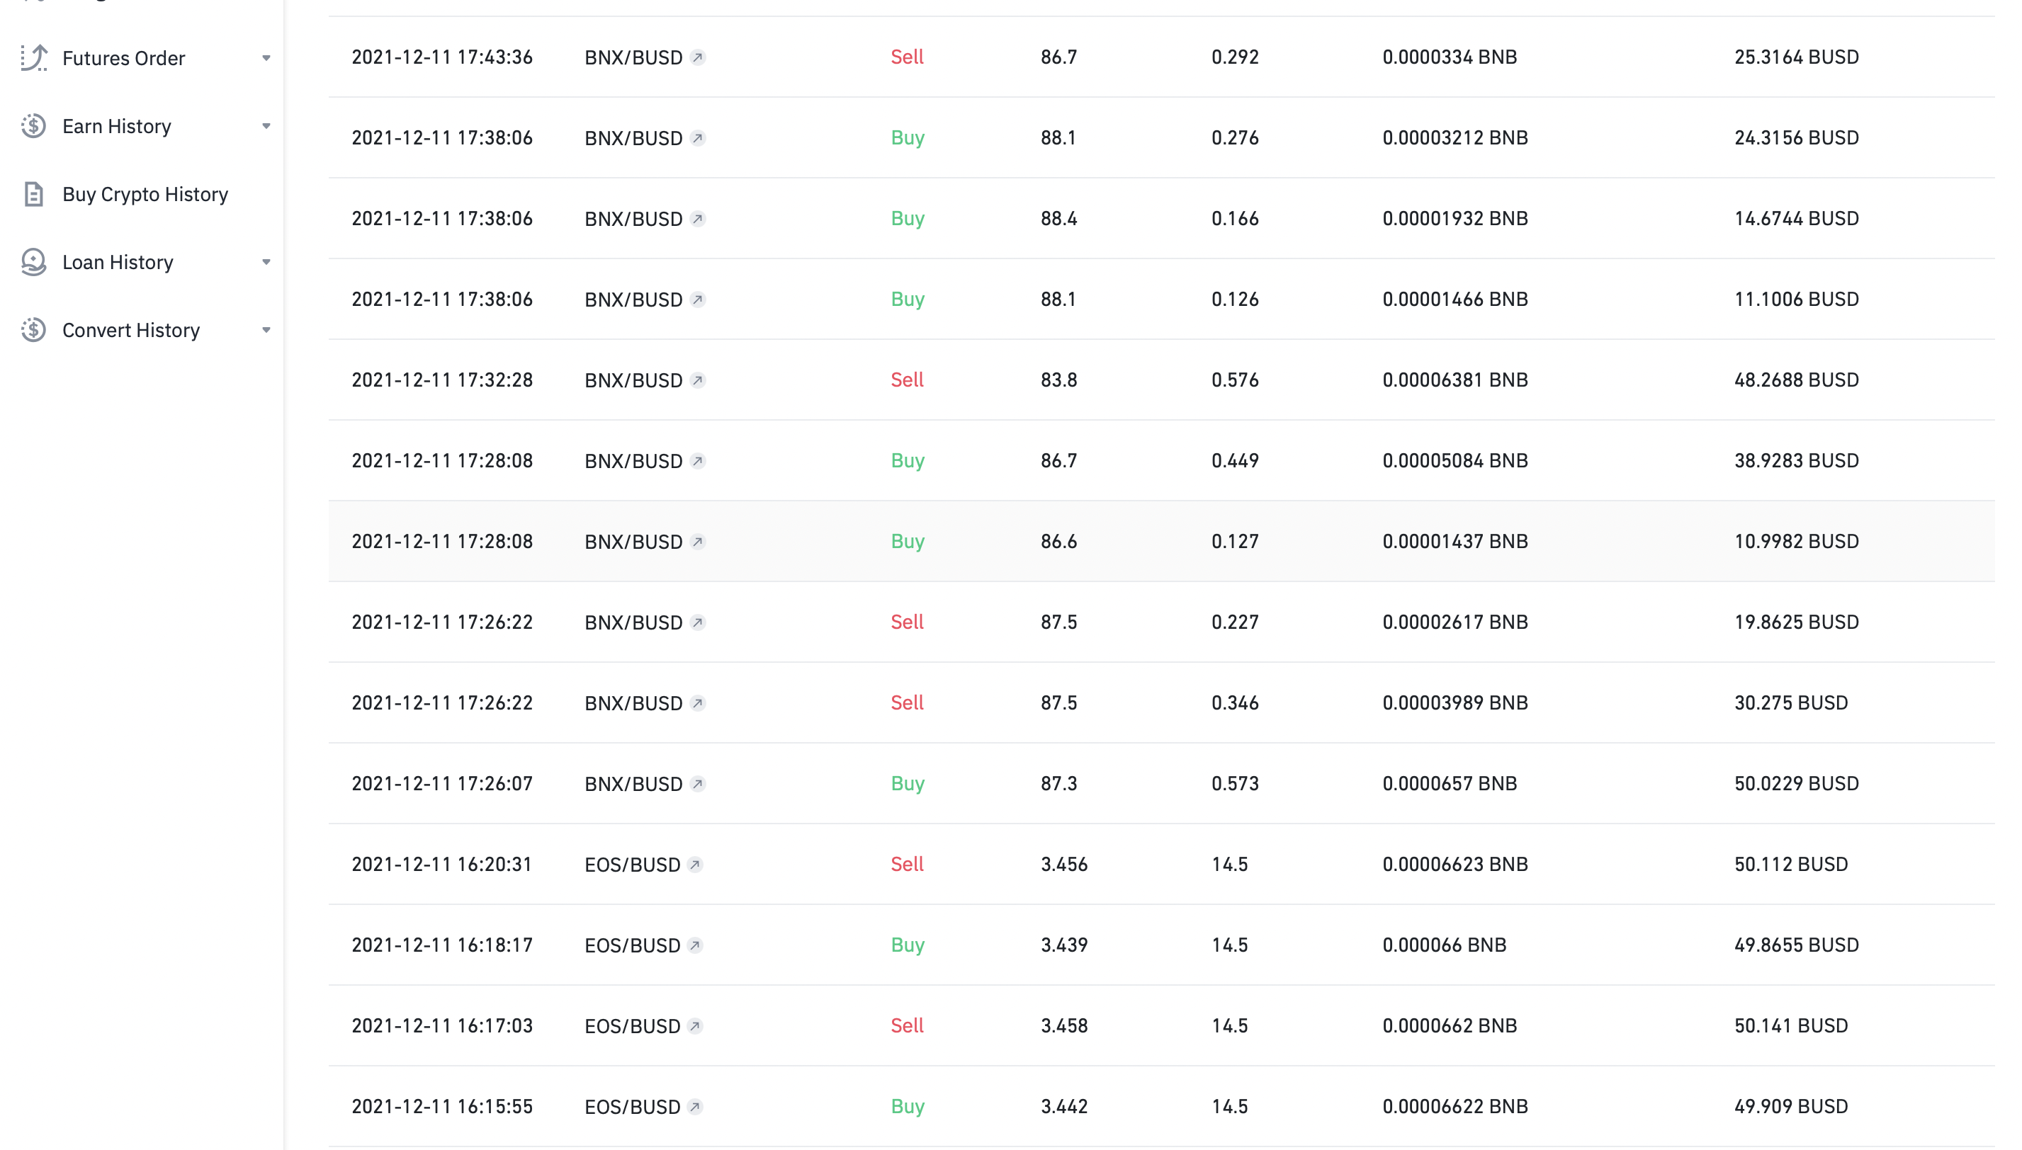

Slide 13
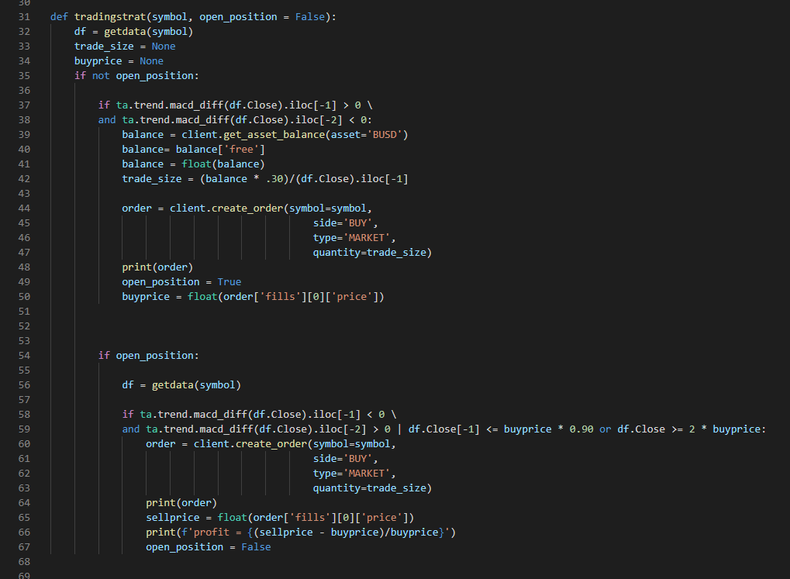
Strategy 2: MACD cross on the hourly chart.
Pandas for data handling
Binance client to get information from Binance
A condition statement for the body of the execution code as well as the strategy.

Slide 14
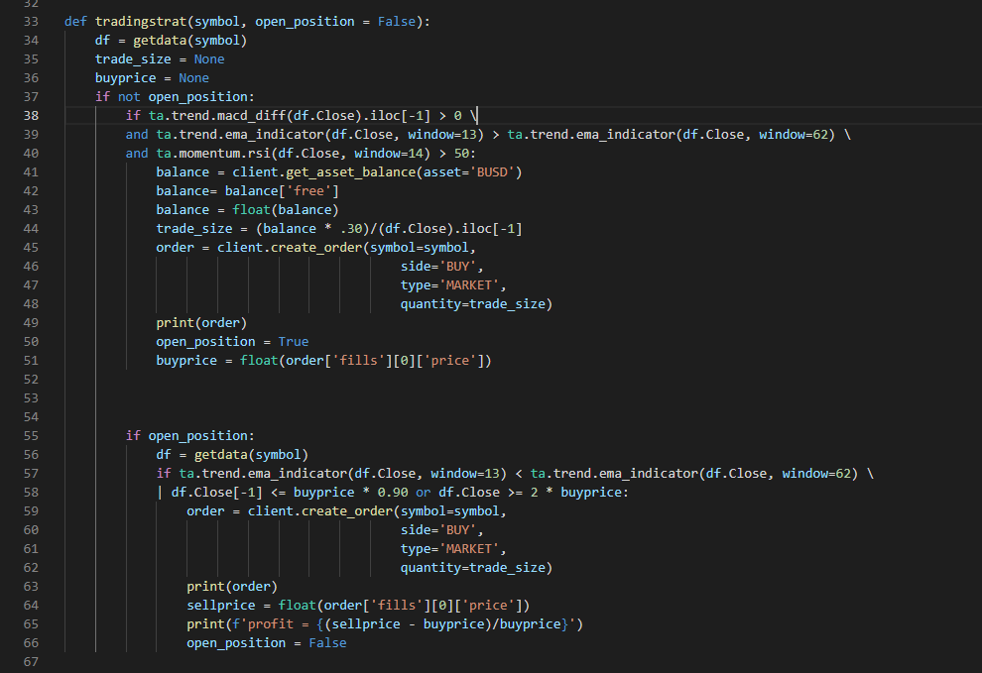
Strategy 3: Modified MACD cross, Slow and Fast EMA, and RSI
Pandas for data handling
Binance client to get information from Binance
A condition statement for the body of the execution code as well as the strategy.

Slide 15
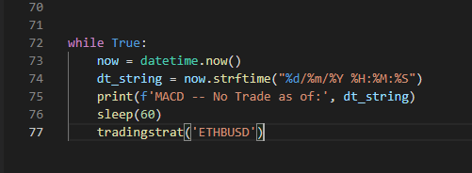
Calling the Function To Run
A simple While true, with an added heart beat to know the code is running.

Slide 16
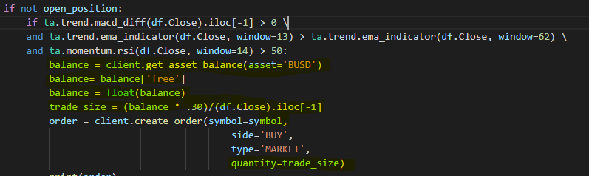
Risk management
For our risk management, we have implemented two simple strategies to help minimise our losses and maximise our gains.
The first. We will only ever trade 10% of our account, and only ever risk 1% on any one trade. As seen below. (please note, example has 30% due to the small funding). This means in up times our trade size will be larger, and in down times will reduce automatically.
Second, is implementing a stop loss and take profit. This compliments the first risk management step. Our stop loss is set at 10%, and our take profit is set at 100%. The TP has been set as we have never hit that with our strategy.

Slide 17
Performance of Strategy 2 & 3
As mentioned earlier, the performance on the back tests were quite promising. Although past performance can not be relied on to accurately predict future performance, this has not stopped Damo and myself getting super excited to deploy this live and start our mission to the moon.
We tested this on different time frames and different assets, and we found that the hourly data on ETH/USD (we will be using ETH/BUSD) gave us the best results.
We used the SPY as our market reference in the back tests.

Slide 18
Things we would like to improve and implement.
Have a buy and sell strategy. We have noticed our biggest draw downs come from visable down trends. We have also noticed our system could take advantage of these moves and potentially minimise drawdowns, if not (optimistically) eliminate them.
We would like to run the system live for an extended period of time and take feedback of whats happened to be able to tweak and modify as needed.
Loop through a bunch of different assets and asset classes, so we are not just focussed on the one asset. This was started with strategy one in order to take advantage of the big movers.
Implement a more rigorous money and risk management system. At the moment we only have stop losses, take profits and trading size allocation limits. This needs improvement.
Improve our back testing code. At the moment, it does not take into account our stop loss (or take profit). This means that some of our gains could have potentially dipped below our stop loss before turing into a gain. It also means that some of our bigger losses would have been capped at 10%.

Slide 19
Questions

